Slide 1

Introduction to ML strategy
Orthogonalization
deeplearning.ai

Slide 2
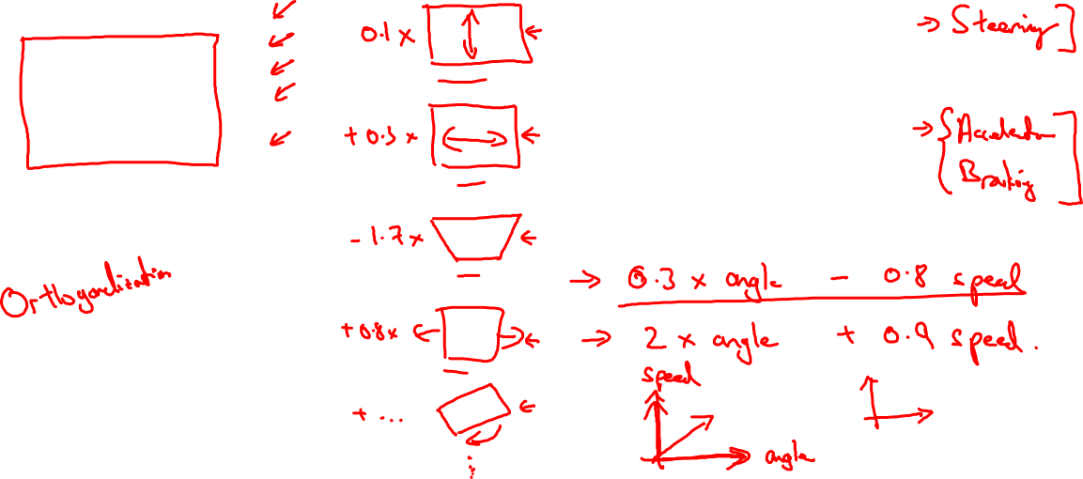
TV tuning example
Car
Notes:
Orthoganalization:
就是很清楚要调试哪一个 超参数
而不影响其他表现
如果有一个knob
能调0.1X多长。。。同时又能调。。。
Change all the same time，就不能达到我们想要的。
========
Stearing: 方向
Accelerate, braking
假如说有一个东西
能同时控制 方向和 速度，以一个固定值
这个东西肯定不如
单一的stearing, accelerate, braking好用
所以我们想要的是正交的：
就是我们调一个东西的时候， 和它成九十度的东西，不受影响

Slide 3
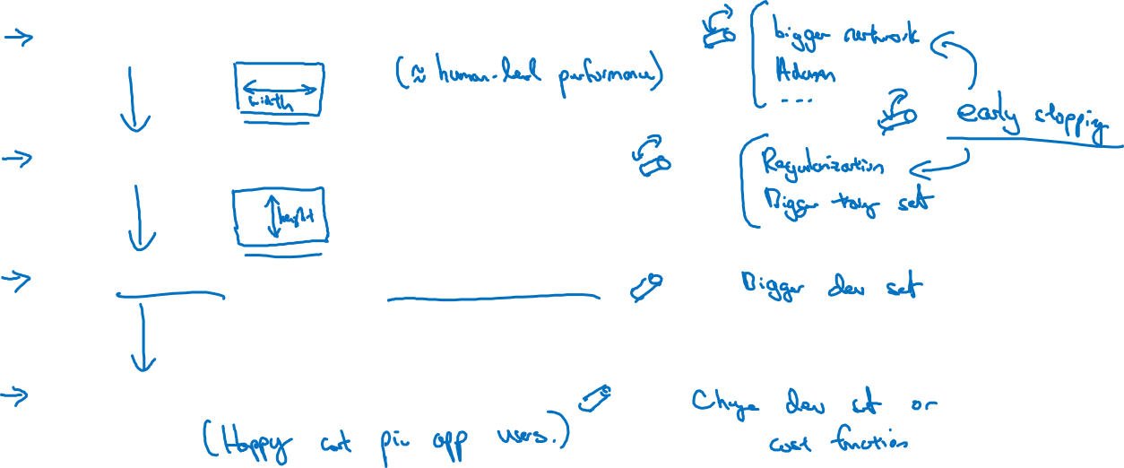
Chain of assumptions in ML
Fit training set well on cost function
Fit dev set well on cost function
Fit test set well on cost function
Performs well in real world
Notes:
要确保四件事：
1.
I tend not to use early stopping.
It's not a bad technique, quite a lot of people do it.
But I personally find early stopping difficult to think about.
Because this is an op that simultaneously affects how well you fit the training set,
because if you stop early, you fit the training set less well.
It also simultaneously is often done to improve your dev set performance.
So this is one knob that is less orthogonalized,
because it simultaneously affects two things.

